Slide 1
Large & Fast: Exploiting Memory Hierarchy
Computer Organization & Design
David A. Patterson
John L. Hennessy
Dr. Farhan Hussain

Slide 2
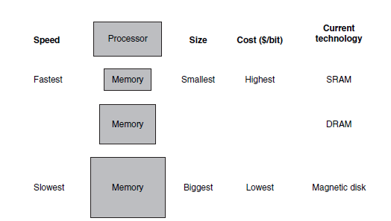
Memory Hierarchy

Slide 3
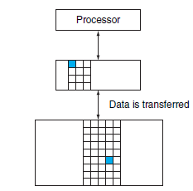
Memory Hierarchy

Slide 4
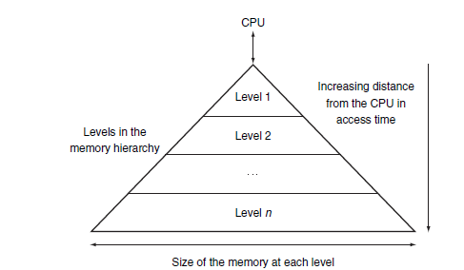
Memory Hierarchy

Slide 5
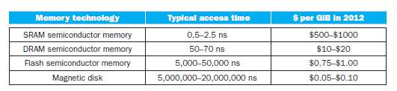
Memory Technologies

Slide 6
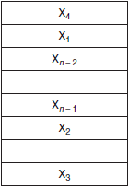
How a Cache Works

Slide 7
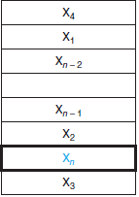
How a Cache Works

Slide 8
HINT
Temporal Locality
Spatial Locality

Slide 9
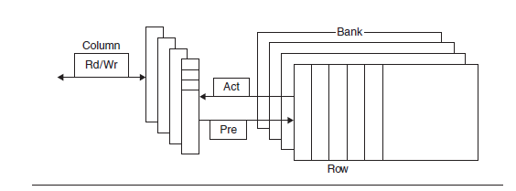
A Cache

Slide 10
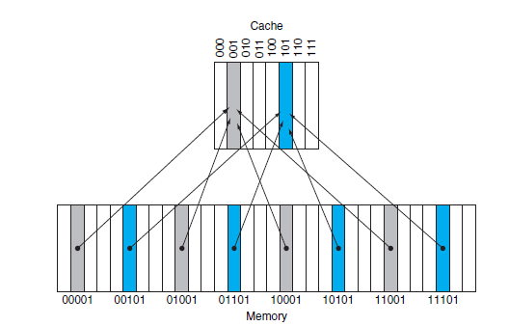

Slide 11
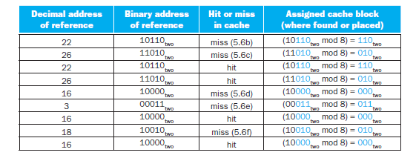

Slide 12
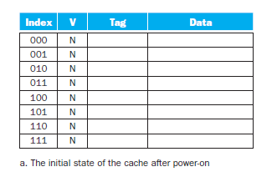

Slide 13
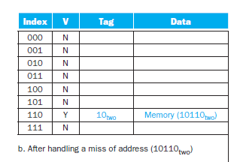

Slide 14
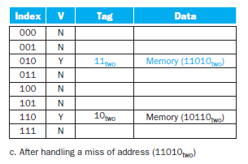

Slide 15
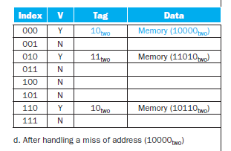

Slide 16
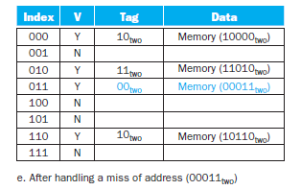

Slide 17
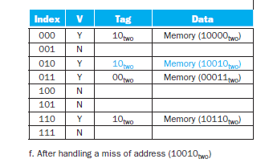

Slide 18
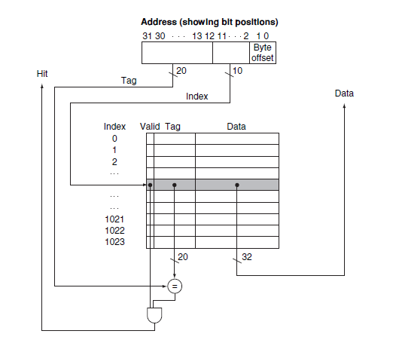

Slide 20
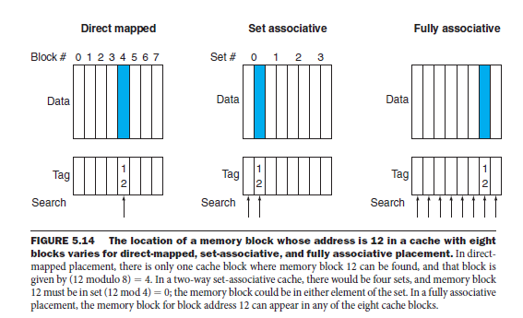

Slide 21
Example
How many total bits are required for a direct-mapped cache with 16 KB of data and 4-word blocks, assuming a 32-bit address?

Slide 22
Example
Consider a cache with 64 blocks and a block size of 16 bytes. To what block number does byte address 1200 map?

Slide 23
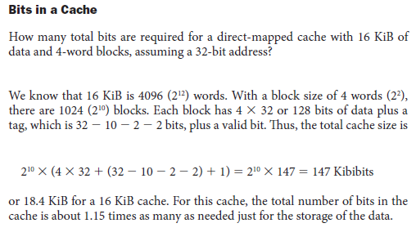

Slide 24
Direct Mapped Cache
Where a block can be placed in exactly one location.
There is a direct mapping from any block address in memory to a single location in the upper level of the hierarchy.

Slide 25
Fully Associative Cache
A cache structure in which a block can be placed in any location in the cache.

Slide 26
Set-Associative Cache
A cache that has a fixed number of locations
(at least two) where each block can be placed.

Slide 27
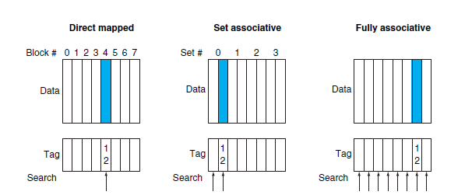
Example
Placement of block 12 in a cache with eight blocks total, according to the three block placement policies.

Slide 28
MIPS gives each program its own 32 bit address space
Programs can access any byte in their 32 bit address space
What if you don’t have 4GB (2³² bytes) of memory

Slide 29
Example
Assume there are three small caches, each consisting of four one-word blocks. One cache is fully associative, a second is two-way set-associative, and the third is direct-mapped. Find the number of misses for each cache organization given the following sequence of block addresses: 0, 8, 0, 6, and 8.

Slide 30
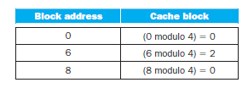
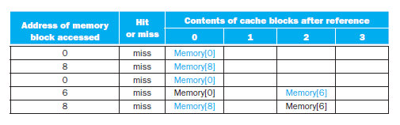
Solution: Direct Map

Slide 31

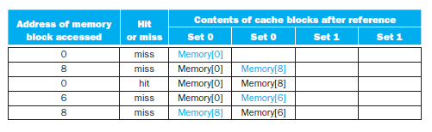
Solution: Set Associative Cache

Slide 32
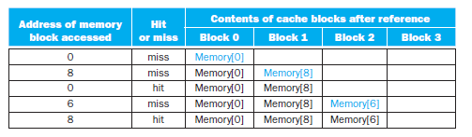
Solution: Fully Associative

Slide 36
Assume add is 4 clock cycles, multiply is 20 clock cycles, divide is 40 clock cycles and load is 4 clock cycles. Using the code segment below show the overall status tables when the ADD.D is ready to commit.

Slide 37
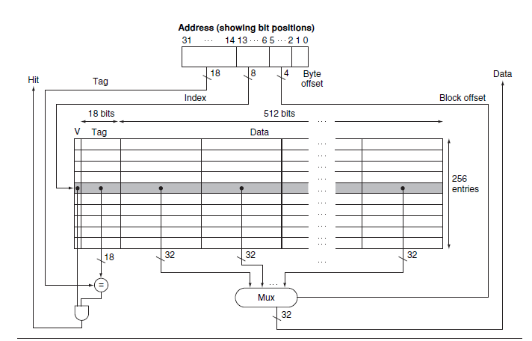

Slide 38
Always 32 bits in MIPS
Size depends upon installed memory
32 bit program address space (4GB)
30 bit RAM address space (1GB)
ADDRESS
0x00000000
??
Crash if we try to access more than 1GB
0xFFFFFFFF

Slide 39
How do programs share the memory
Where we do put them

Slide 40
32 bit RAM address space (4GB)
Program 1
1GB
Program 2
(2GB)
Program 3
(2GB)

Slide 41
32 bit RAM address space (4GB)
Program 1
1GB
Program 2
(2GB)
Program 3
(2GB)
Program 1 & 2 fit
(they use 3 GB of memory leaving 1GB free)

Slide 42
32 bit RAM address space (4GB)
Program 3
(2GB)
Program 1
Program 2
Program 1 & 2 fit
(they use 3 GB of memory leaving 1GB free)

Slide 43
32 bit RAM address space (4GB)
1GB free
Program 1
1GB
Program 3
(2GB)
Program 2
Quit program 1
Program 2 uses 2GB of memory leaving 2GB free
1GB free

Slide 44
32 bit RAM address space (4GB)
1GB free
Program 1
1GB
Program 3
(2GB)
Program 2
Can’t run program 3
(even though we have enough space)
Memory Fragmentation
1GB free

Slide 45
Each program can access any 32-bit memory address
What if multiple programm access the same address
sw r2, 1024(r0) will write to the address 1024 regardless of the program that’s running
They can corrupt each other or crash each other
Security & reliability

Slide 46
RAM address space
10000
Program 1
1GB
Address 1024
Program 2
(2GB)

Slide 47
RAM address space
310x000x
Program Address
1024
Program 1
1GB
Address 1024
Program 1 stores the bank balance at address 1024
Program 2 stores the exam marks at address 1024
Program 2
(2GB)
Program Address
1024

Slide 48
If all programs have access to the same 32 bit memory space:
Can crash if less than 4GB of RAM memory in the system
Can run out of memory if we run multiple programs
Can corrupt other program’s data

Slide 49
How do we solve this
Key to the problem “SAME MEMORY SPACE”
Can we give each program its own virtual memory space
If so we can
Separately map each programs memory space to the RAM memory
Mapping gives the flexibility in how we use the physical RAM

Slide 50
Always 32 bits in MIPS
Size depends upon installed memory
32 bit program address space (4GB)
30 bit RAM address space (1GB)
ADDRESS
0x00000000
??
Crash if we try to access more than 1GB
0xFFFFFFFF

Slide 51
Virtual Memory
VIRTUAL MEMORY takes program addresses and maps them to RAM addresses

Slide 52

Always 32 bits in MIPS
Size depends upon installed memory
32 bit program address space (4GB)
30 bit RAM address space (1GB)
ADDRESS
0x00000000
MAP
0xFFFFFFFF

Slide 53
Map some of the program’s address space to the disk
When we need it we bring it to the memory
VM maps address 1 to RAM 0
VM maps address 0 to RAM1
Program loads address 0
Program loads address 1
Program 0
Program 1
Program2
Program 3
Program 1
Program 0
Program 2
Program loads address 2
MAP
Program loads address 3
VM maps address 2 to RAM2
VM does not have any more space in RAM
Notes:
Write the program address space and RAM address space

Slide 54
VM updates the map to point data data 0 to disk
Map some of the program’s address space to the disk
When we need it we bring it to the memory
Program loads address 0
VM moves oldest data (0) to Disk
Program loads address 1
Program 0
Program 1
Program2
Program 3
Program 1
Program 3
Program 2
Program loads address 2
MAP
Program loads address 3
VM maps address 3 to RAM 1
Disk
Program 1
Notes:
Write the program address space and RAM address space

Slide 55
Mapping uses the secondary storage to give the illusion of unlimited memory

Slide 56
How do we use the holes left when program quits
We can map a program address to RAM address however we like
32 bit RAM address space (4GB)
1GB free
Program 3
(2GB)
Program 3 MAP
Program 2
Program 2
(2GB)
Program 2 MAP
1GB free

Slide 57
With virtual memory program addresses map to RAM addresses
Each program has its own mapping
Mapping can put program data where ever it wants in the RAM

Slide 58
RAM address space
10000
0.0005
Program Address
1024
RAM Address
3
Program 1
1GB
Program 1 MAP
Program 1 stores the bank balance at address 1024
VM maps it to RAM address 3
Program 2 stores the exam marks at address 1024
VM maps it to RAM address 6
Security & Reliability
Program Address
1024
RAM Address
6
Program 2
(2GB)
Program 2 MAP

Slide 59
Program 1’s & 2’s addresses map to different RAM addresses
Because each program has it’s own address space, they cannot access each other’s data

Slide 60
Virtual Memory:
What the program sees
e.g. LDR r4, 1024(r0) accesses virtual address r0+1024=1024
Physical Memory:
The physical RAM installed in the computer
e.g. if there is 4GB of RAM installed you have physical addresses from 0 to 2³² - 1

Slide 61
Virtual address:
what the program uses
in MIPS, this is the full 32 bit address space (0 to 2³²-1)
Physical address:
What the hardware uses to talk to the RAM
Address space is determined by how much RAM is installed

Slide 62
Program executes a load specifying a virtual address
Computer translates the address to the physical address in the memory
Program
Virtual address space
RAM
Physical address space
Translation
From VA→PA
Data for r3
LDR r3, 1024(r0)
Data for r3
MAP
VA | PA
512 | 12
786 | Disk
1024 | 2
VA 1024
PA 2

Slide 63
If the PA is not in the memory the OS loads it from disk
The computer then reads the RAM using the PA and returns the data to the program
Program
Virtual address space
RAM
Physical address space
Translation
From VA→PA
Data for r3
LDR r3, 1024(r0)
LDR r2, 512 (r0)
ADD r4, r2, r3
LDR r5, 786(r0)
Data for r3
MAP
VA | PA
512 | 12
786 | Disk
1024 | 2
VA 786

Slide 64
If the PA is not in the memory the OS loads it from disk
The computer then reads the RAM using the PA and returns the data to the program
Program
Virtual address space
RAM
Physical address space
Translation
From VA→PA
Data for r3
LDR r3, 1024(r0)
LDR r2, 512 (r0)
ADD r4, r2, r3
LDR r5, 786(r0)
Data for r3
Data for r5
MAP
VA | PA
512 | 12
786 | Disk
1024 | 1
VA 786

Slide 65
If the PA is not in the memory the OS loads it from disk
The computer then reads the RAM using the PA and returns the data to the program
Update Translation MAP
Program
Virtual address space
RAM
Physical address space
Translation
From VA→PA
Data for r3
LDR r3, 1024(r0)
LDR r2, 512 (r0)
ADD r4, r2, r3
LDR r5, 786(r0)
Data for r3
Data for r5
MAP
VA | PA
512 | 12
786 | 3
1024 | 1
VA 786

Slide 66
If the PA is not in the memory the OS loads it from disk
The computer then reads the RAM using the PA and returns the data to the program
Update Translation MAP
Program
Virtual address space
RAM
Physical address space
Translation
From VA→PA
Data for r3
LDR r3, 1024(r0)
LDR r2, 512 (r0)
ADD r4, r2, r3
LDR r5, 786(r0)
Data for r3
Data for r5
MAP
VA | PA
512 | 12
786 | 3
1024 | 1
VA 786

Slide 67
The map from VA to PA address is called Page table
So far one page table entry for every VA
How many entries for 32 bit virtual address??
1 for every byte = 2³² (4 billion)
1 for every word= 2³⁰ (1 billion)

Slide 68
If we don’t have a page table entry we cannot access them because we cannot find the physical address
How can we make it more manageable
What if we divided memory up into chunks (pages) instead of words

Slide 69
4KB pages
Each entry now covers 4KB of data
MAP
Translates from VA→PA
MAP
Translates from VA→PA
MAP
VA | PA
512 | 12
786 | Disk
1024 | 2
MAP
VA | PA
0-4096 | 8192-4096
FINE GRAIN:
MAPS each word address
2³⁰ words to map
COURSE GRAIN:
MAPS chunks of addresses Fewer mappings
Notes:
Exaplaination:

Slide 70
The page table maps larger chunks (pages) of data
Fewer page table entries needed to cover the whole address space
Less flexible
Typically 4KB pages
Sometimes 2MB pages

Slide 71
4KB pages
Each entry now covers 4KB of data
MAP
Translates from VA→PA
MAP
VA | PA
0-4096 | 4096-8191
COURSE GRAIN:
MAPS chunks of addresses Fewer mappings

Slide 72
Virtual Address Space
16382 12280
12287 8192
8191 4096
4095 0
Physical Address
Space
12287 8192
8191 4096
4095 0
What is the physical address for virtual address 4

Slide 73
Virtual Address Space
16382 12280 | 4KB
12287 8192 | 4KB
8191 4096 | 4KB
4095 0 | 4KB
Physical Address
Space
12287 8192 | 4KB
8191 4096 | 4KB
4095 0 | 4KB
It will map to 4 bytes offset from corresponding physical page:
4096+4
VA is 4 bytes offset from the start of virtual page at VA 0

Slide 74
What happens on a 32 bit machine with 256 MB of RAM and 4 KB pages
Each PTE handles 4KB of address space
Virtual Page No.
Page Offset.
Virtual Address
20 bits | 12 bits
For each page we have 4096 addresses (12) bits that don’t get translated
Page table
Physical Address
16 bits | 12 bits
Physical Page No.
Page Offset.

Slide 75
4095 0 | 4KB
What happens on a 32 bit machine with 256 MB of RAM and 4 KB pages
Each PTE handles 4KB of address space
Virtual Page No.
Page Offset.
Virtual Address
20 bits | 12 bits
For each page we have 4096 addresses (12) bits that don’t get translated
Page table
Physical Address
16 bits | 12 bits
Physical Page No.
Page Offset.
8191 4096 | 4KB

Slide 76
TRANSLATION
Virtual Address Space
2³²-1
Physical Address Space
20 bits | 12 bits
Virtual Address Space
16382 Virtual Page No. 3 12280 | 4KB
12287 Virtual Page No. 2 8192 | 4KB
8191 Virtual Page No. 1 4096 | 4KB
4095 Virtual Page No. 0 0 | 4KB
16 bits | 12 bits
Physical Address
Space
Which Page
12287 8192 | 4KB
8191 4096 | 4KB
4095 0 | 4KB
Which Page
Page Offset
Page Offset

Slide 77
Virtual Address (VA) size set by ISA
Virtual Page No.
Page Offset.
Virtual Address
20 bits | 12 bits
4KB page =12 bits for page offset
Same for VA & PA
No translation
 | Physical Page No.
0x00000 | Disk
0x00001 | 0x0003
0x00002 | 0x0005
0xfffff | 0x00f6
Page Table Entry (PTE) tells which page
Physical Address (PA) size set by amount of RAM
Physical Address
16 bits | 12 bits
Physical Page No.
Page Offset.

Slide 78
Virtual Page No.
Page Offset.
Virtual Address
20 bits | 12 bits
 | Physical Page No.
0x00000 | Disk
0x00001 | 0x0003
0x00002 | 0x0005
0xfffff | 0x00f6
Physical Address
16 bits | 12 bits
Physical Page No.
Page Offset.

Slide 79
Virtual Page No.
Page Offset.
Virtual Address
20 bits | 12 bits
 | Physical Page No.
0x00000 | Disk
0x00001 | 0x0003
0x00002 | 0x0005
0xfffff | 0x00f6
Physical Address
16 bits | 12 bits
Physical Page No.
Page Offset.

Slide 80
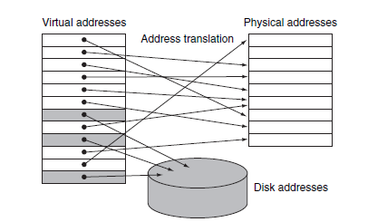

Slide 81
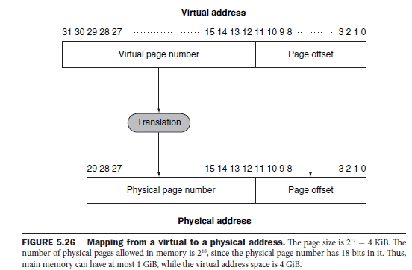

Slide 82
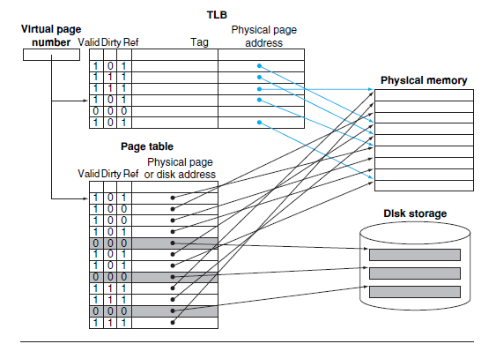

Slide 83
TLB
Virtual Page No.
Page Offset.
Virtual Address
20 bits | 12 bits
 | Physical Page No.
0x00000 | Disk
0x00001 | 0x0003
0x00002 | 0x0005
0xfffff | 0x00f6
Physical Address
16 bits | 12 bits
Physical Page No.
Page Offset.

